Slide 1
SEVEN SEGMENT DISPLAY

Slide 2
Team members:
SABBANI.NIKHITHA (2005A42002)
SREERAM.AAKASH(2005A42003)
YALAMANCHI.SRI HARSHA (2005A42004)
BATHINI.VINEETHA (2005A42005)

Slide 3
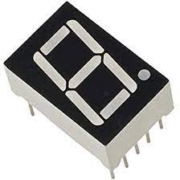
Introduction :
The objective is to convert BCD code to seven segment decoder..
It is an combinational circuit that converts decimal digit in BCD to an appropriate code for the selection of segments in an indicator used to display decimal digit.
In BCD (Binary Coded Decimal), a binary pattern is used to represent a decimal number. A seven segment display is used to display hexadecimal numeral by seven LEDs arranged in a definite pattern.
The BCD is represented by its equivalent binary pattern.
Seven segment display is an electronic device which consists of seven LEDs arranged in a definite pattern, which is used to display Hexadecimal numerals.

Slide 4

Description:
Seven segment displays are the output display device that provide a way to display information in the form of image or text or decimal numbers which is an alternative to the more complex dot matrix displays.
It is widely used in digital clocks, basic calculators, electronic meters, and other electronic device that display numerical information. It consists seven segments of light emitting diodes (LEDs) which is assembled like numerical 8.
This project introduces how to make a 7-segment display using only LED’s a battery, a breadboard, a resistor, IC’s and some wires.
We have used quad and gates ,quad or gates, and hex inverter and LED’s for the display.In decoder ,we have placed logic gates and seven segments of light emitting diodes (LEDs) which is assembled like numerical 8 is done using LED’s.

Slide 5
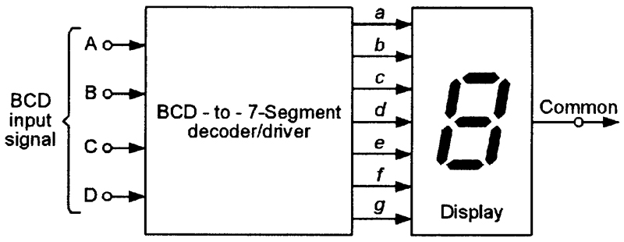
Block diagram:

Slide 6
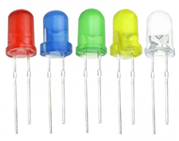
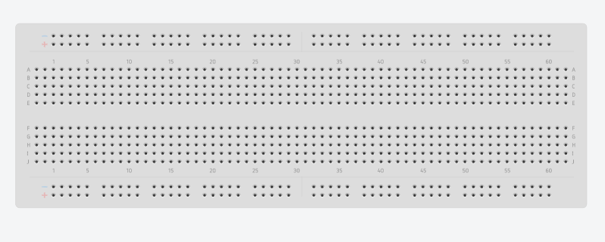
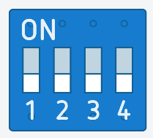
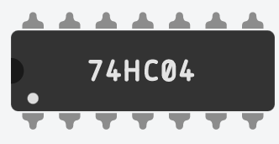
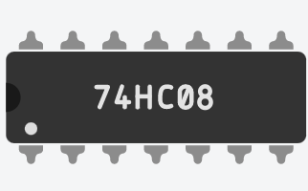
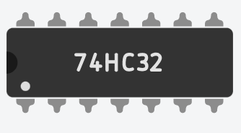
Components Used:
Bread board dip switch LED’S
Hex inverter Quad AND gates Quad OR gates

Slide 7
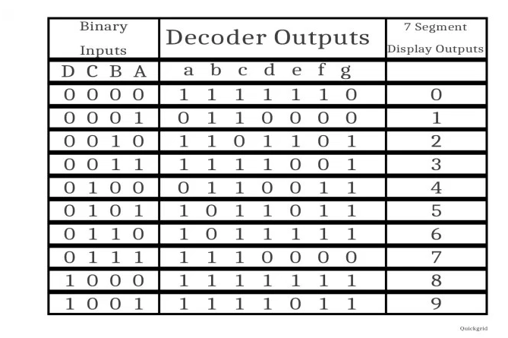
Truth table:

Slide 8
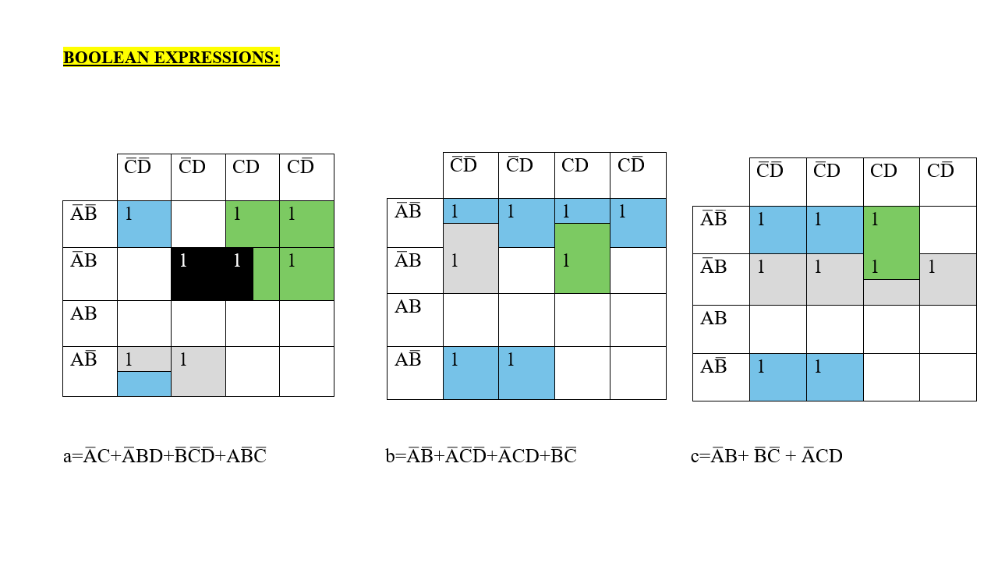

Slide 9
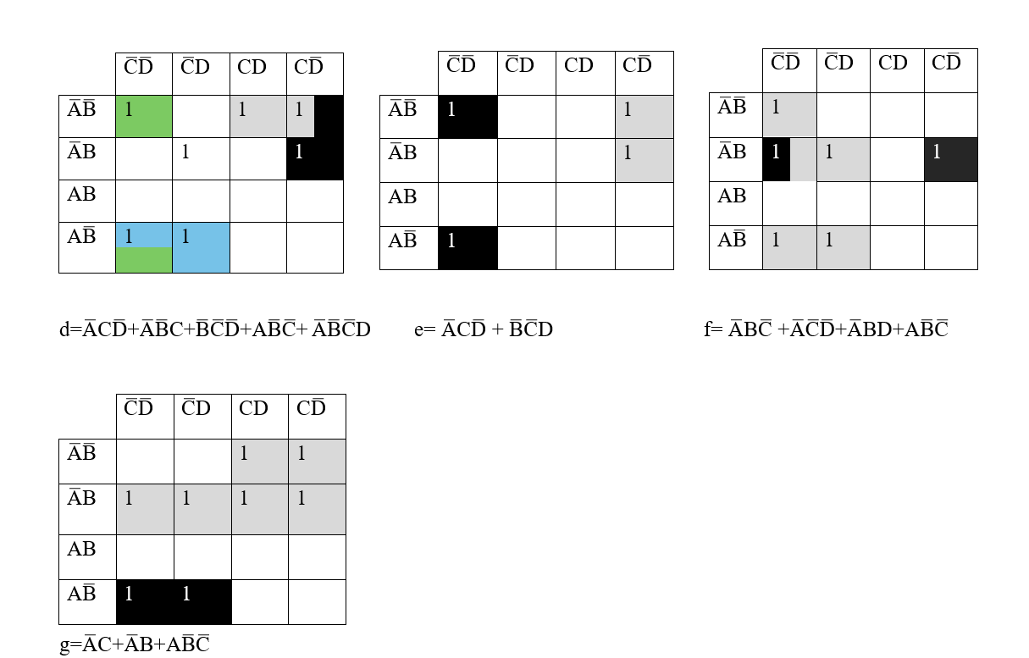

Slide 10
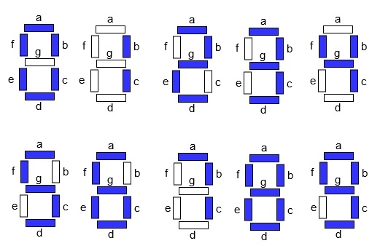
Output display:

Slide 11
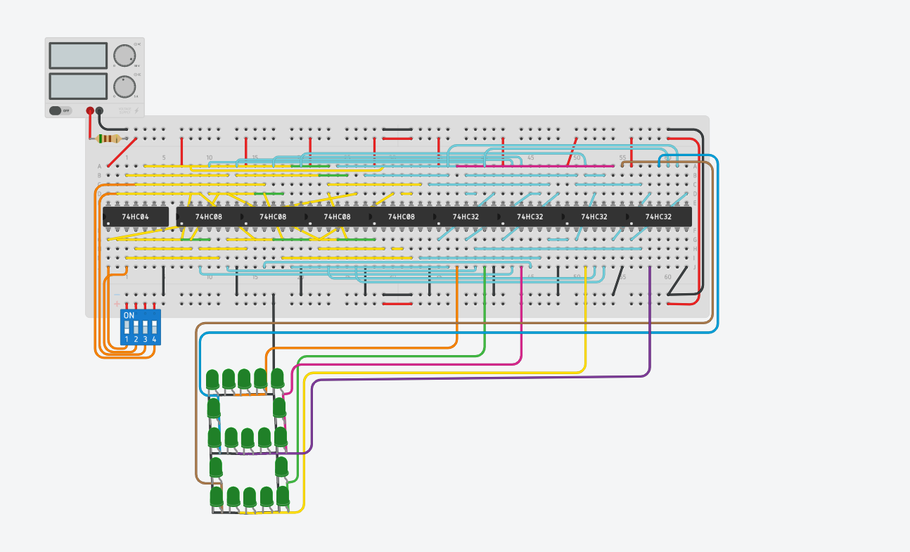
Software Circuit Connection:

Slide 12
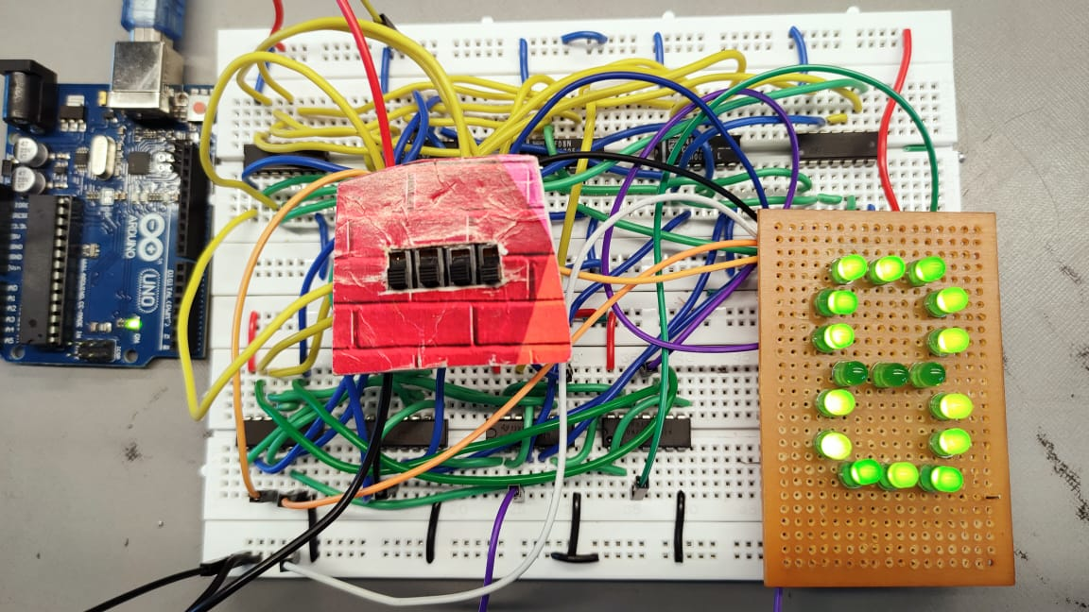
Hardware Circuit Connection:

Slide 13
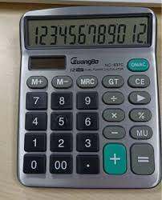
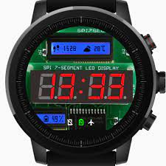
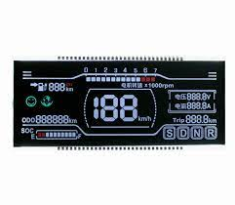
Applications of seven segment display:
Digital clocks
Clock radios
Calculators
Wrist watches
Speedometers
Motor-vehicle odometers
Radio frequency indicators

Slide 14
Conclusion:
We have done this 7 segment display using gates and only LED’S arranged in 8 pattern. The device has vast use in most old and modern devices. Seven-segment displays are used to display the digits in calculators, clocks, various measuring instruments, digital watches and digital counters.

